Slide 1
Introduction to Macroeconomics

Slide 2
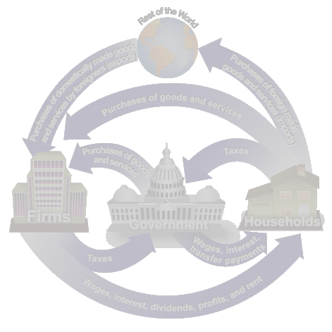
Introduction to Macroeconomics
Microeconomics examines the behavior of individual decision-making units—business firms and households.
Macroeconomics deals with the economy as a whole; it examines the behavior of economic aggregates such as aggregate income, consumption, investment, and the overall level of prices.
  Aggregate behavior refers to the behavior of all households and firms together.
<number> of 31

Slide 3
Introduction to Macroeconomics
Microeconomists generally conclude that markets work well. Macroeconomists, however, observe that some important prices often seem “sticky.”
Sticky prices are prices that do not always adjust rapidly to maintain the equality between quantity supplied and quantity demanded.
<number> of 31

Slide 4
Introduction to Macroeconomics
Macroeconomists often reflect on the microeconomic principles underlying macroeconomic analysis, or the microeconomic foundations of macroeconomics.
<number> of 31

Slide 5
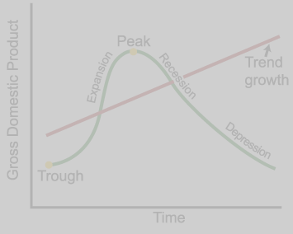
The Roots of Macroeconomics
The Great Depression was a period of severe economic contraction and high unemployment that began in 1929 and continued throughout the 1930s.
<number> of 31

Slide 6
The Roots of Macroeconomics
Classical economists applied microeconomic models, or “market clearing” models, to economy-wide problems.
However, simple classical models failed to explain the prolonged existence of high unemployment during the Great Depression. This provided the impetus for the development of macroeconomics.
<number> of 31

Slide 7
The Roots of Macroeconomics
In 1936, John Maynard Keynes published The General Theory of Employment, Interest, and Money.
Keynes believed governments could intervene in the economy and affect the level of output and employment.
During periods of low private demand, the government can stimulate aggregate demand to lift the economy out of recession.
<number> of 31

Slide 8
Recent Macroeconomic History
Fine-tuning was the phrase used by Walter Heller to refer to the government’s role in regulating inflation and unemployment.
The use of Keynesian policy to fine-tune the economy in the 1960s, led to disillusionment in the 1970s and early 1980s.
<number> of 31

Slide 9
Recent Macroeconomic History
Stagflation occurs when the overall price level rises rapidly (inflation) during periods of recession or high and persistent unemployment (stagnation).
<number> of 31

Slide 10
Macroeconomic Concerns
Three of the major concerns of macroeconomics are:
  Inflation
  Output growth
  Unemployment
<number> of 31

Slide 11
Inflation and Deflation
Inflation is an increase in the overall price level.
Hyperinflation is a period of very rapid increases in the overall price level. Hyperinflations are rare, but have been used to study the costs and consequences of even moderate inflation.
Deflation is a decrease in the overall price level. Prolonged periods of deflation can be just as damaging for the economy as sustained inflation.
<number> of 31

Slide 12
Output Growth:
Short Run and Long Run
The business cycle is the cycle of short-term ups and downs in the economy.
The main measure of how an economy is doing is aggregate output:
  Aggregate output is the total quantity of goods and services produced in an economy in a given period.
<number> of 31

Slide 13
Output Growth:
Short Run and Long Run
A recession is a period during which aggregate output declines. Two consecutive quarters of decrease in output signal a recession.
A prolonged and deep recession becomes a depression.
Policy makers attempt not only to smooth fluctuations in output during a business cycle but also to increase the growth rate of output in the long-run.
<number> of 31

Slide 14
Unemployment
The unemployment rate is the percentage of the labor force that is unemployed.
The unemployment rate is a key indicator of the economy’s health.
The existence of unemployment seems to imply that the aggregate labor market is not in equilibrium. Why do labor markets not clear when other markets do?
<number> of 31

Slide 15
Government in the Macroeconomy
There are three kinds of policy that the government has used to influence the macroeconomy:
  Fiscal policy
  Monetary policy
  Growth or supply-side policies
<number> of 31

Slide 16
Government in the Macroeconomy
Fiscal policy refers to government policies concerning taxes and spending.
Monetary policy consists of tools used by the Federal Reserve to control the quantity of money in the economy.
Growth policies are government policies that focus on stimulating aggregate supply instead of aggregate demand.
<number> of 31

Slide 17
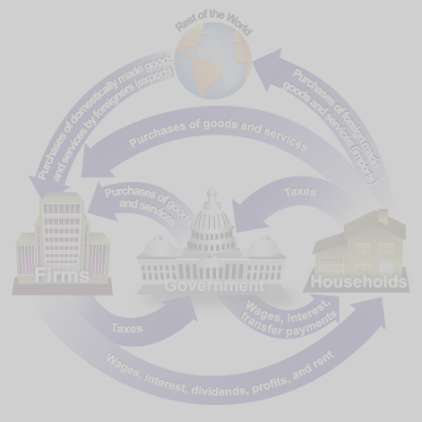
The Components of the Macroeconomy
The circular flow diagram shows the income received and payments made by each sector of the economy.
<number> of 31

Slide 18

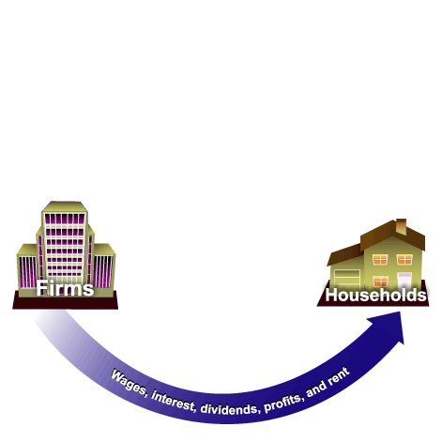
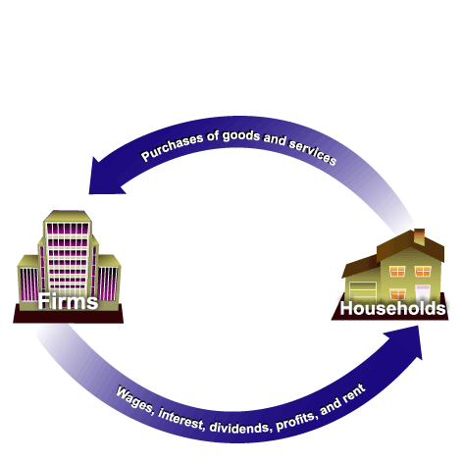
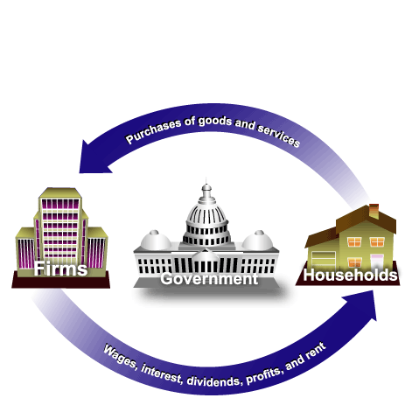
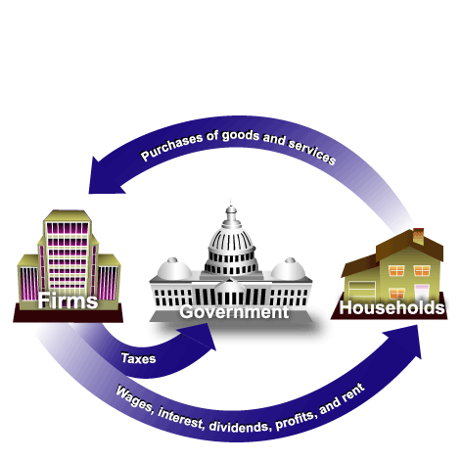
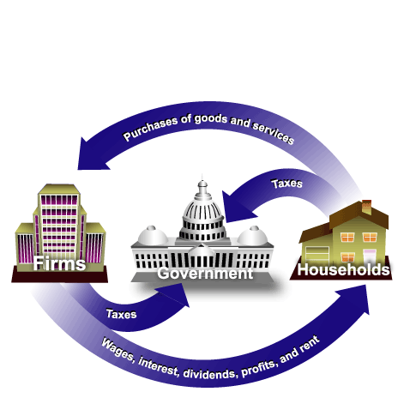
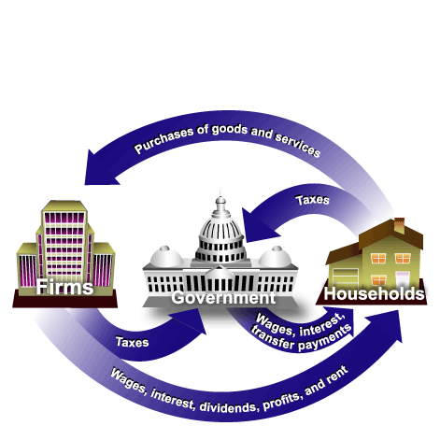
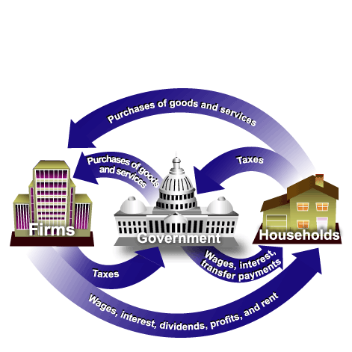
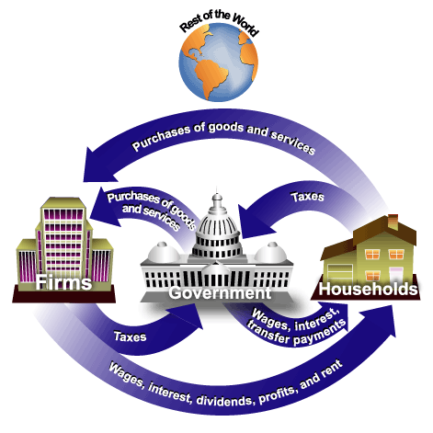
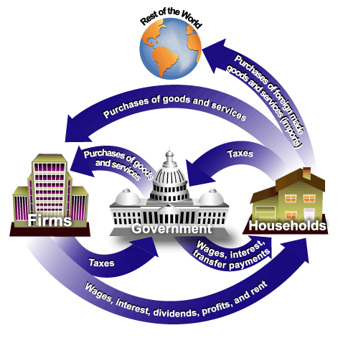
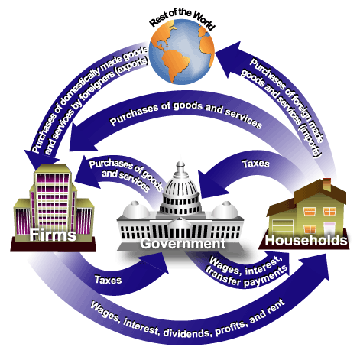
The Components of the Macroeconomy
Everyone’s expenditure is someone else’s receipt. Every transaction must have two sides.
<number> of 31

Slide 19
The Components of the Macroeconomy
Transfer payments are payments made by the government to people who do not supply goods, services, or labor in exchange for these payments.
<number> of 31

Slide 20
The Three Market Arenas
Households, firms, the government, and the rest of the world all interact in three different market arenas:
  Goods-and-services market
  Labor market
  Money (financial) market
<number> of 31

Slide 21
The Three Market Arenas
Households and the government purchase goods and services (demand) from firms in the goods-and services market, and firms supply to the goods and services market.
In the labor market, firms and government purchase (demand) labor from households (supply).
  The total supply of labor in the economy depends on the sum of decisions made by households.
<number> of 31

Slide 22
The Three Market Arenas
In the money market—sometimes called the financial market—households purchase stocks and bonds from firms.
  Households supply funds to this market in the expectation of earning income, and also demand (borrow) funds from this market.
  Firms, government, and the rest of the world also engage in borrowing and lending, coordinated by financial institutions.
<number> of 31

Slide 23
Financial Instruments
Treasury bonds, notes, and bills are promissory notes issued by the federal government when it borrows money.
Corporate bonds are promissory notes issued by corporations when they borrow money.
<number> of 31

Slide 24
Financial Instruments
Shares of stock are financial instruments that give to the holder a share in the firm’s ownership and therefore the right to share in the firm’s profits.
  Dividends are the portion of a corporation’s profits that the firm pays out each period to its shareholders.
<number> of 31

Slide 25
The Methodology of Macroeconomics
Connections to microeconomics:
  Macroeconomic behavior is the sum of all the microeconomic decisions made by individual households and firms. We cannot understand the former without some knowledge of the factors that influence the latter.
<number> of 31

Slide 26
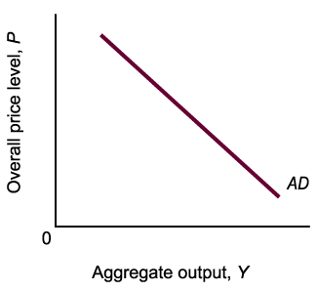
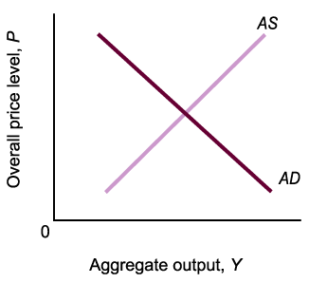
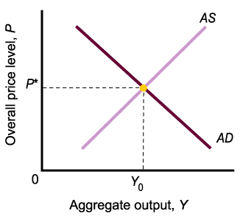
Aggregate Supply and
Aggregate Demand
Aggregate demand is the total demand for goods and services in an economy.
Aggregate supply is the total supply of goods and services in an economy.
Aggregate supply and demand curves are more complex than simple market supply and demand curves.
<number> of 31

Slide 27
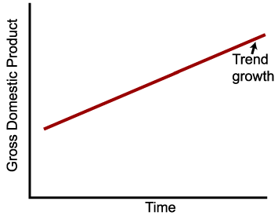
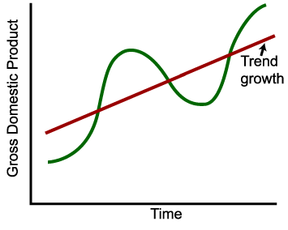
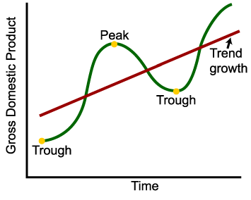
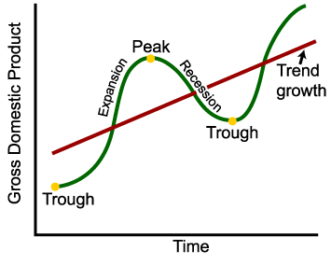
Expansion and Contraction:
The Business Cycle
An expansion, or boom, is the period in the business cycle from a trough up to a peak, during which output and employment rise.
A contraction, recession, or slump is the period in the business cycle from a peak down to a trough, during which output and employment fall.
<number> of 31

Slide 28
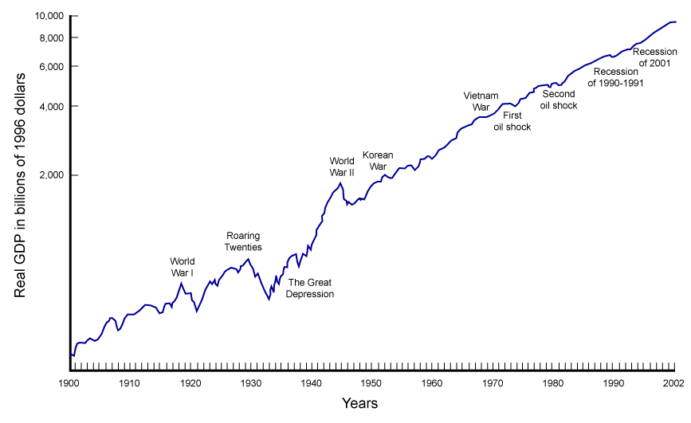
Real GDP, 1900-2002
<number> of 31

Slide 29
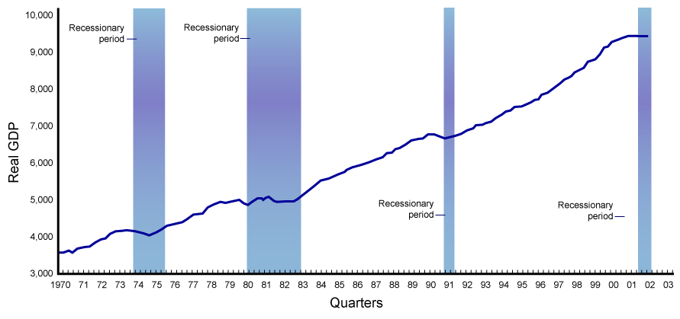
Real GDP, 1970 I-2003 II
<number> of 31

Slide 30
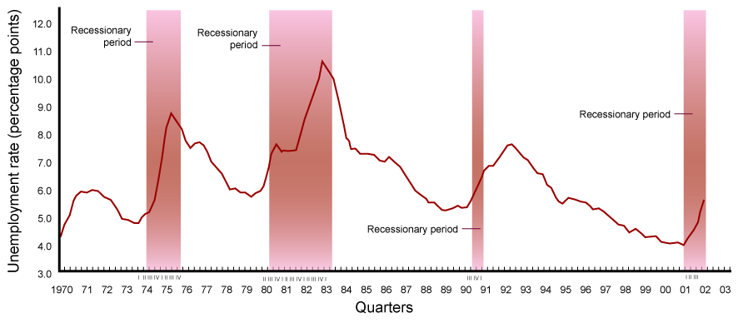
Unemployment Rate, 1970 I-2003 II
<number> of 31

Slide 31
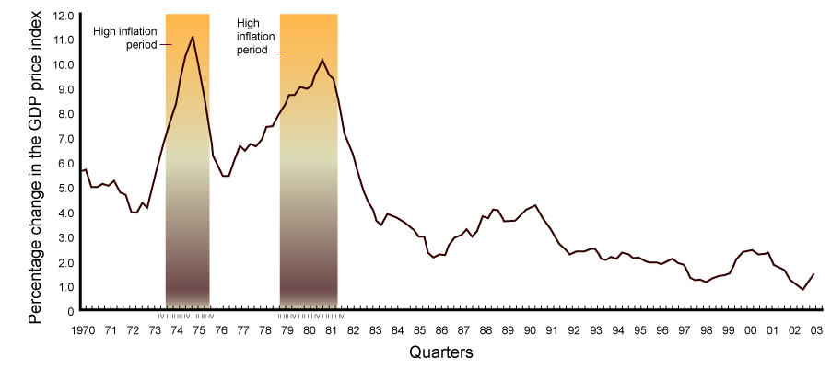
Percentage Change in the GDP Deflator (Four-Quarter Average), 1970 I-2003 II
<number> of 31

Slide 32
Review Terms and Concepts
aggregate behavior
aggregate demand
aggregate output
aggregate supply
business cycle
circular flow
contraction, recession, or slump
corporate bonds
deflation
depression
dividends
expansion or boom
fine tuning
fiscal policy
Great Depression
hyperinflation
inflation
macroeconomics
microeconomic foundations of macroeconomics
microeconomics
monetary policy
recession
shares of stock
stagflation
sticky prices
supply-side policies
transfer payments
Treasury bonds, notes, bills
unemployment rate
<number> of 31

